Slide 1
ChemPartner Biologics Capability
May 4, 2017

Slide 2
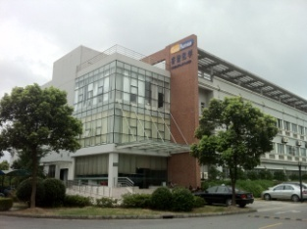
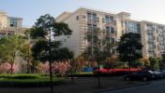
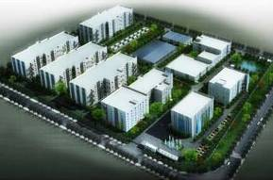
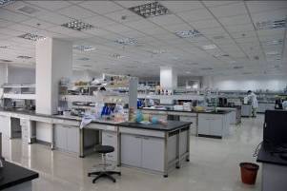
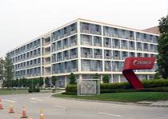
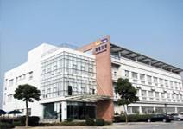
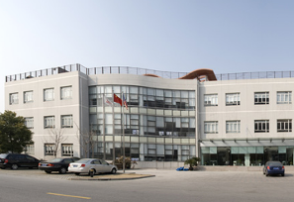
ChemPartner and Biologics History
2013
2013
Biologics CMC
LM DMPK
1,800 scientists
2010
2009
2010
  Biologics discovery built up
  ~1,655 Scientists
2008
2007
2009
  Gateway Pharmaceuticals
  ~1,500 Scientists
2006
2007
  Biology & DMPK built up
  US$30mm TPG investment
  ~980 Scientists
2005
2006
  Chengdu ChemPartner
  ~570 Scientists
2003
2003
  Shanghai ChemPartner
  ~100 Scientists
2002
2002
  ChemExplorer
  5 Scientists
Notes:
2

Slide 3
Integrated Biologics Services: Discovery to Development
Therapeutic Antibody Development
Target
Validation
Lead
Generation
Candidate
Production
Pre- Clinical
Clinical
GMP
Text
Drug Discovery
Animal
Human
Commercialization
Biologics Discovery
Biologics development
Pharmacology
DMPK
3

Slide 4
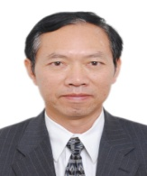



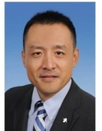
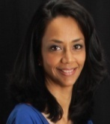



Biologics Discovery Leadership Team
Biologics Discovery
(Louis Liu)
> 30 (7) yrs
Protein Science
Cheng Fang
Zensun Sci&Tech,
11 (10) yrs
Antibody Discovery
Teddy Yang
Genentech/Novartis/
Ruiyi, 15 (2) yrs
Shireen Khan Dnax/Xoma 15(1) yrs
Antibody Engineering
Protein Analytical
Lishan Kang
Novo Nordisk.
11(2) yrs
Zhengxing Qu
Enzon/Immunomedics 25(5)yrs
Shan He
NIH 7(3) yrs
ADC Discovery
Dapeng Sun
ImmunoGen
/NEB 14(2)
Brian Qin
MIT/Sysmex 5(1) yrs
>220
Total Employee
20%
PhD/MD Scientists
> 50%
M.S. Scientists
10%
U.S./EU Experiences

Slide 5
Biologics Discovery Platforms
Reagent Generation
Recombinant protein
Recombinant cell line
Assay Development
Binding Assay
Functional assay
Antibody Generation
Antibody Engineering
Candidate Selection
Recombinant Antibody
Physical Properties
Hybridoma
(WT & Tg mice)
Phage Display
(Im & naïve Lib)
VH/VL sequencing
Humanization
Affinity Maturation
Binding property and bioactivity
Manufactur-ability
In vivo PK/TOX
/Efficacy
Screening and Characterization

Slide 6
Discovery Capability Highlights
Integrated antibody discovery services
  Understanding of target biology
  Target validation
  From target to candidate antibodies
  Extension to product development and preclinical studies for IND filing
Difficult targets
  Antibody discovery for high homology and low immunogenicity targets
  Proprietary genetic immunization
  Extensive experiences for multi-transmembrane proteins (GPCR, ion channel, etc)
Fully human antibody generation
    Harbour Transgenic mice – successful experiences since 2012
    Trianni transgenic mice – preferred service provider and partner
    Phage display technology – proprietary human naïve libarary
  ADC discovery
  Full capability from biologics, chemistry to in vivo studies
Notes:
MDSC: myeloid derived suppressor cells
In this study normal splenocytes were labeled with CFSE. Each time cells divide, the fluorescent intensity will decrease by half since they are equally divided into the daughter cells. Anti-CD3 induced cell proliferation indicated by the appearance of peaks of lower intensity, the addition of splenocytes from 4T1 model (as a source of MDSCs) completely inhibited the anti-CD3 induced proliferation.

Slide 7
Discovery Project process and timeline
Reagent Generation
3-4 months
Assay Development
3-4 months
Lead and Candidate
Generation
6-8 months
Antibody engineering
Biophysical property
PK/ In vivo efficacy
3-6 months
Stable cell line
/PD/CMC
Preclinical studies

Slide 8
Experiences for 60 Therapeutic Antibody Programs
60
IS Programs
14
Oncology
16
Immuno-Oncology
7
Neuroscience
9
Immunology
Major Disease Fields
Oncology
Immuno-oncology
Immunology
Neuroscience
Metabolics
AMD
Cardiovacular
Aging and Degenerative

Slide 9

  COMMON TOPICS ABOUT ANTIBODY GENERATION

Slide 10
Project Design and Initiation
Study the biology of the target
Project proposal
Project workplan
Project team and management

Slide 11
Reagent Generation
Expression vector construct and plasmid
Protein Reagents
Cell lines
Other reagents

Slide 12
Assay Development
Reagent validation
Binding assays
Functional assay

Slide 13
Available Approaches for Antibody Generation in CP
Hybrdoma technology
  WT mice, rat and hamsters
  Transgenic mice (Harbour mice, Trianni mice)
Phage display technology
  Naïve library
  Immune library

Slide 14
Immunogens
Peptides
Proteins
Cells
DNAs
Nanodisc
Animals
Mouse
Rat
Hamster
KO
Tg
Adjuvant
Freund’s
Gerbu
TiterMax
RIBI
Routes
IP
Hock
S.C.
IV
Combined Immunization Strategies

Slide 15
Representative Immunization Plan
Cohorts | Immunogens | Route | Animal Strains | Group size | Dosage (ug or cells) | Adjuvant
1 | Purified Proteins | I.P. | BalbC | 10 | 25~50 | CFA/IFA
2 |  | I.P. | SJL | 10 | 25~50 | CFA/IFA
3 |  | hock | BalbC | 5 | 5 | Gerbu
4 |  | hock | SJL | 5 | 5 | Gerbu
5 | Over-expression cell lines | I.P. | BalbC | 10 | 0.5-1x10⁷ cells | N/A
6 |  | I.P. | SJL | 10 | 0.5-1x10⁷ cells | N/A
7 | DNA plasmid | Gene gun | BalbC | 5 | 4 | N/A
8 |  | Gene gun | SJL | 5 | 4 | N/A

Slide 16
Typical Antibody Generation and Screening Process
< 10
/E1
> 10,000
> 1000
> 100
< 10
/E2
3-5 Candidates
Potency
CDR sequence
Property
< 10
/E3
< 10
/E4
Hybridoma
Screening
Production/purification
Functional
Antibody
Candidate
Antibody

Slide 17
Antibody Engineering and Informatics Analysis
VH/VL Sequencing
Confirm protein sequences by MS
Validation by chimeric antibody production
Sequence Analysis
CDR grafting and back mutation by in silico modeling
Production of variants and characterization
Affinity Maturation
Random mutagenesis and phage display
Variants production and characterization
Humanization
Engineering for lead optimization
Fc function, expression, PTMs, stability
1-2 months
  Sequence alignment
  Hotspots analysis
1-2 days
2-3 months
3-4 months
1-2 months
17

Slide 18
Manufacturability/Drugability Assessment
Manufacturability/
Drugability
Candidate mAb Selection
Engineering/
optimization
Cell line development
Process development
Formulation

Slide 19
Biophysical Characterization Capabilities
 | Parameter |  | Method
Primary sequence | Composition |  | Amino acid analysis (AAA)
 | Sequence confirmation |  | Peptide mapping, LC-MS/MS
 | Glycosylation analysis |  | LC-MS/MS
 | Disulfide bond shuffling |  | LC-MS/MS
 | Charge analysis |  | cIEF, IEX
 | Degradation |  | SEC, RPC, SDS-PAGE, cIEF, IEX, HIC
Secondary structure | CD
Tertiary structure | Intrinsic fluorescence
 | 2nd derivative UV
Aggregation | Aggregates | SEC-MALLS, SDS-PAGE
 | Size | Dynamic Light Scattering (DLS)
Thermal stability | Capillary DSC
 | High throughput DLS
Activity | Biacore, ELISA, Cell based assays

Slide 20
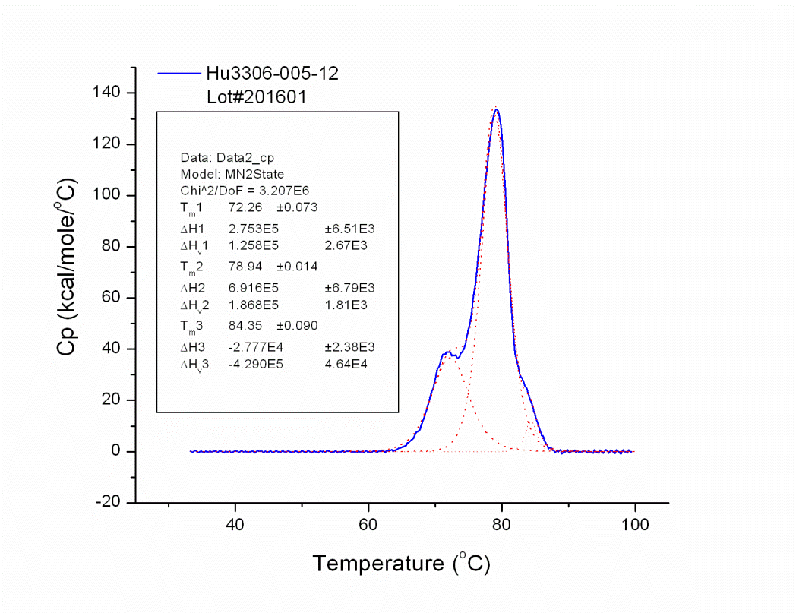
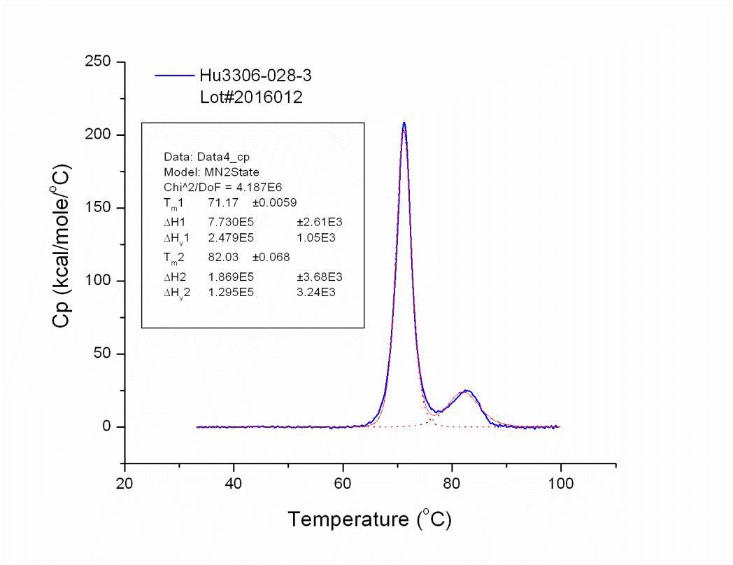
  Case Study _ Manufacturability data for humanized mAbs
DSC
3306-hu005-12
3306-hu028-3
Antibody Code | T_{M} of Fab ( °C)
Hu3306-005-12 | 78.94
Hu3306-028-3 | 71.17
DLS
Heat induced aggregation
Antibody Code | T_{onset} ( °C)
Hu3306-005-12 | 74
Hu3306-028-3 | 66

Slide 21
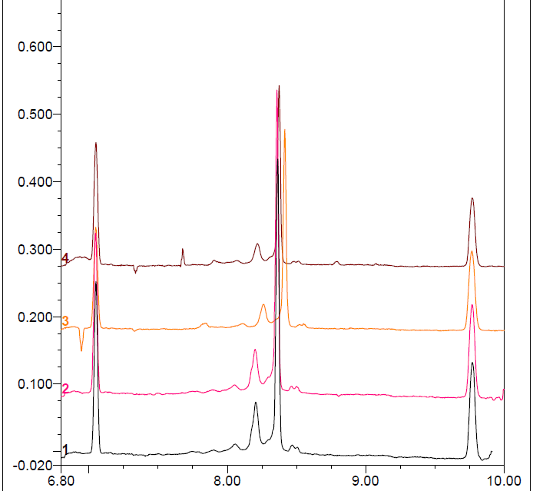
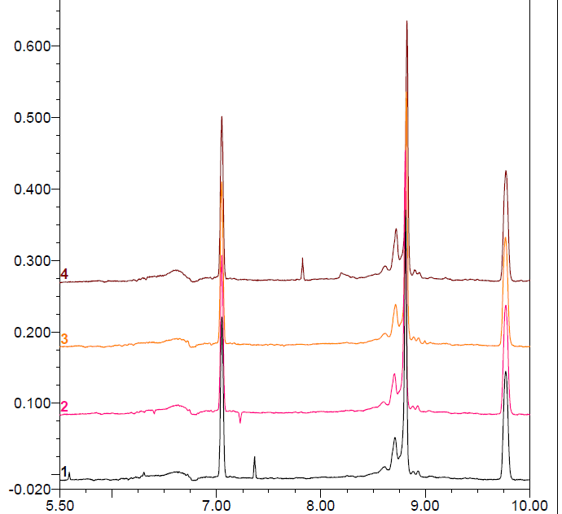
Case Study _ Manufacturability data for humanized mAbs
Storage
3306-hu005-12
CiEF
3306-hu028-3
2
Store at different temp for 1w：
Ab No. | Temp. | Aggregation (%)
 |  | 1 | 2 | 3 | ave-Agg
3306-005-12 | 4℃ | 3.21 | 4.26 | 3.24 | 3.57
 | 25℃ | 4.22 | 4.38 | 4.04 | 4.21
 | 37℃ | 3.74 | 3.68 | 3.86 | 3.76
 | -80℃ | 3.18 | 3.2 | 3.08 | 3.15
3306-028-3 | 4℃ | 0.07 | 0.19 | 0.16 | 0.14
 | 25℃ | 0.08 | 0.25 | 0.27 | 0.20
 | 37℃ | 0.2 | 0.21 | 0.21 | 0.21
 | -80℃ | 0.17 | 0.26 | 0.19 | 0.21
2
7.05
7.05
9.77
9.77
1
1
3
37℃
3
-80℃
4℃
25℃
25℃
4℃
37℃
-80℃
4℃
Ab No. | Temp. | Aggregation (%)
 |  | 1st | 2nd | 3th
3306-005-12 | 4℃/-80℃ | 2.89 | 4.33 | 2.9
 | 25℃/-80℃ | 3.32 | 3.44 | 3.73
 | 37℃/-80℃ | 3.16 | 3.52 | 3.58
3306-028-3 | 4℃/-80℃ | 0 | 0 | 0
 | 25℃/-80℃ | 0 | 0 | 0
 | 37℃/-80℃ | 0 | 0 | 0
Freeze thawing
-80℃
3 cycles
25℃
37℃
Ab No. | Conc. | Aggregation (%)
3306-005-12 | 30 mg/ml | 2.99
 | 60 mg/ml | 3.25
 | 100 mg/ml | 2.98
3306-028-3 | 30 mg/ml | 0
 | 60 mg/ml | 0
 | 100 mg/ml | 0
Concentration
30mg/ml
60mg/ml
100mg/ml

Slide 22
  Protein Science and Reagent Generation

Slide 23
Protein Science Capabilities
50 + Scientific team members
1500 + m² Lab space
30 + AKTA purification systems
100 + proteins produced yearly
1000 + Antibodies produced yearly
mgs –grams transient production scale
3-4 weeks production by E coli system
4-8 weeks production by mammalian system
50+ protein/mAb production in parallel

Slide 24
Molecular Cloning
The typical sources for the template DNA
  Digital sequences, synthesize
  Commercial cDNA clones (Invitrogen, Origene, Thermo, etc.)
  Plasmid constructs provided by the clients
DNA synthesis
  Custom synthesis at Genewiz, Sangon, Invitrogen, etc.
Number of clones can be generated in parallel
  >100
Available vectors and tags for gene expression
  More than 50 vectors available for various applications (detail see next)
  Most frequently used tags: His tag, GST, Flag, Ig Fc
  Any other tags can be requested and generated
  Biotinylation (E.coli, Bac/insect cells)
Timelines
  Vector construction ─ 1-3 weeks for most constructs
  Depending on gene size and the complexity of construction scheme

Slide 25
Protein Expression Systems
Expression System | Weekly capacity | Commonly used medium | Strain/cell line
E.coli | 200 L | LB, TB, 2xYT | BL21(DE3), BL21(DE3)pLysS, BL21-AI, BL21-codon plus, Origami(DE3) , Arctic express (DE3) RP
Yeast (Pichia) | 50 L | YPD, BMGY, BMMY | GS115, KM71, SMD1168, X33
Insect | 100 L | SF900II SFM Express Five SFM | Sf9, Sf21, High Five
Mammalian cells | 150 L | FreeStyle™ 293 Exp Medium CD FortiCHO™ Medium | HEK293, CHO

Slide 26
Protein Purification
Purification methods
  Affinity chromatography - Protein A/G/L, Ni-Sepharose, Glutathione-Sepharose, Anti-FLAG- Agarose
  IEX – SP, Q, DEAE
  HIC
  SEC
Purification equipments
  Centrifuges
  Depth filtration systems
  Ultrafiltration/diafiltration apparatus
  ÄKTA systems and various columns

Slide 27
Quality Control and Characterization for Proteins
Protein quality | Assay/analysis | Instrument/method
Basic information | Concentration, purity, endotoxin | HPLC-SEC, SDS-PAGE
Physical | Extinction coefficient (A280) | UV/Vis Spectrophotometer
 | Native protein size | SEC-MS, RPLC-MS
 | Oligomeric/Polymeric status Intact protein mass | LC-MS
Impurity/ homogeneity | Aggregates/Particles | FFF-MALLS, SEC, DLS
 | Host-cell protein | SDS-PAGE, WB, LC-MS/MS
 | Host-cell DNA contamination | qPCR
Integrity | Amino acid composition (AAA) Peptide mapping Disulfide bonds mapping N-/C-terminal residue analysis | RP-HPLC, LC-MS/MS
Post-translational modification | Deamidation | RP-HPLC, LC-MS/MS
 | Oxidation | RP-HPLC, LC-MS/MS
 | Phosphorylation | iMAC-LC-MS/MS
 | Glycosylation site ID N-linked/O-linked glycan structure Sialylation/α-Gal | 2-AB labeling, LC-MS/MS

Slide 28
  Stable Cell Line Development

Slide 29
Stable Cell line Development Capability Highlights
Cell Line Development and application for Antigen and Assay
Capability
- 10+ scientists
- 20+ cell lines in parallel
- Complete QC methods
- Single and Dual proteins
- Multiple vectors, transfection/infection methods
Experiences
- Supported 50+ IS projects
- 250 + stable cell lines
- 200+ target proteins
- 27+ host cell lines of human, mouse, rat, etc.
- Single and multiple transmembrane proteins
Application
- Immunogen for immunization
- Antigen binding FACS, Acumen
- Ligand binding and stimulation
- Cell signaling and other functional assays
Notes:
MDSC: myeloid derived suppressor cells
In this study normal splenocytes were labeled with CFSE. Each time cells divide, the fluorescent intensity will decrease by half since they are equally divided into the daughter cells. Anti-CD3 induced cell proliferation indicated by the appearance of peaks of lower intensity, the addition of splenocytes from 4T1 model (as a source of MDSCs) completely inhibited the anti-CD3 induced proliferation.

Slide 30
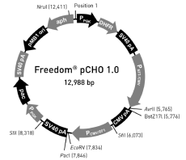

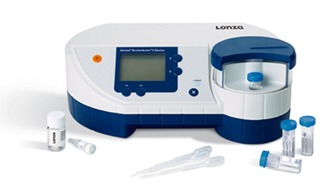
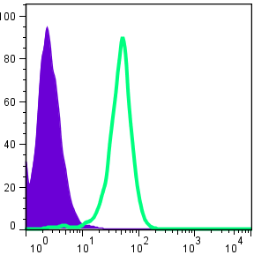



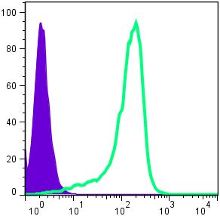
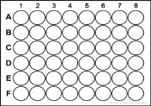
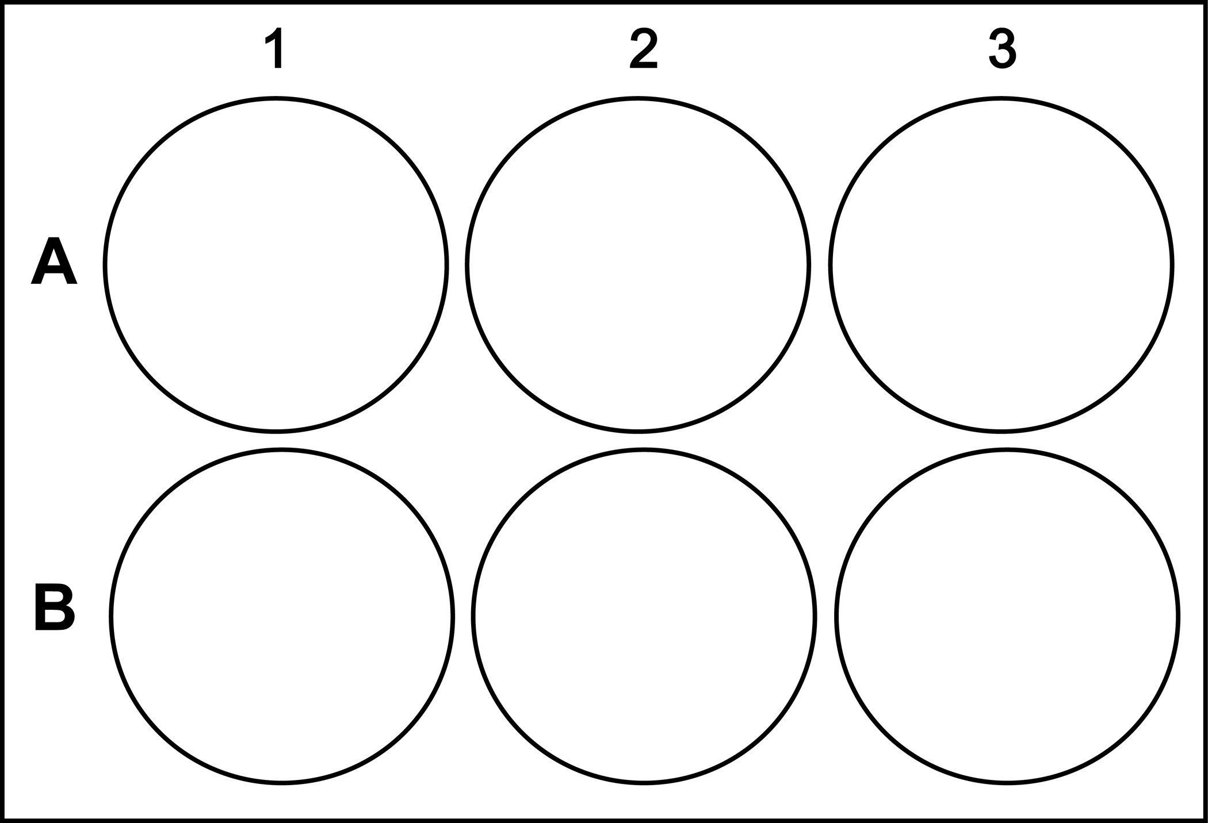

Work Flow of Stable Cell Line Development
×5
Pool FACS
Expression
Vector
Host Cell
Transfection OR
Lentivirus package/infection
Plating cells and pool validation
Top 3-5 Clones
20-30 Clones
Limiting Dilution or FACS sorting
Mycoplasma test
Cell Banking
Characterization by binding and bioassays
Clone expansion and screening

Slide 31
Timeline of Stable Cell Line Development
Vector construction
Trans-fection
Clone selection
Characterization
QC & cell banking
Transfection method: 14 weeks (2-3 months)
4 weeks
1 week
4 weeks
1-2 weeks
3 weeks
Vector construction
Lentivirus packaging
Clone selection
Characterization
QC & cell banking
Infection
Lentiviral infection method: 16 weeks (3-3.5 months)
4 weeks
2 weeks
1 week
4 weeks
1-2 weeks
3 weeks

Slide 32
Extensive Experiences in stable cell line development
List of representative host cell lines used for stable cell line development
Cell line | Description | Culture Properties
HEK293 | Human embryonic kidney cell | adherent
CHOK1 | Chinese hamster ovarian cell | adherent
BA/F3 | Mouse pro-B lymphocyte | suspension
NIH/3T3 | Mouse embryonic fibroblast | adherent
1321N1 | human brain astrocytoma glioma cell | adherent
U2OS | human osteosarcoma cell | adherent
Renca | Murine renal adenocarcinoma cell | adherent
RBL-2H3 | Rat basophilic leukemia cell | adherent
Hep3B | Human hepatocellular carcinoma cell | adherent
Jurkat | Human acute T cell leukemia | suspension
NS0 | murine myeloma cell | suspension
LCL721.221 | Human B lymphocyte | half-suspension
Raji | Human B lymphocyte | suspension

Slide 33
  Screening and Functional Assays

Slide 34
Assay Development and Use in Antibody Discovery
Assay development support
Stage 1
Reagent validation
Binding assays
Functional assays
Stage 3
Lead Screening
Antisera titer and animal selection
Stage 5
Development support
Physicochemical properties
PK/PD/Tox, in vivo efficacy
Stage 2
Assay development
Stage 4
Candidate selection
Characterization of purified mAbs
Protein reagents
Recombinant and endogenous cell lines
Screening of mAb from hybridoma and phage
Chimeric/humanization/affinity maturation
CHO stable cell line, process/CMC development

Slide 35
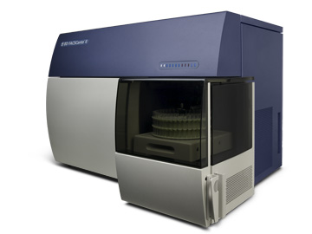
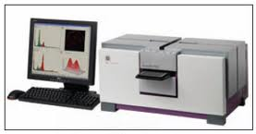
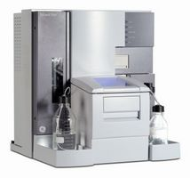
Binding Assays for Ab Screening & Characterization
Binding assays
  Protein based indirect ELISA, competitive ELISA, western blot, immunoprecipitation, IHC, etc.
  Cell based Acumen microplate cytometry, FACS and IF live cells staining
  Epitope mapping and binning by peptide array or competitive ELISA
Affinity and kinetic parameters
  Biacore, Octet Red
Acumen Microplate cytometer
Biacore T-200
FACS Canto II

Slide 36
Target Specific In Vitro Functional Assays
Item | Well established assays
Protein based functional assay | Ligand binding/blocking assay(ELISA)
 | Enzymetic assays
Cell based functional assays 20 + established assays Recombinant cell lines Endogenous cell lines Primary NHP cells Primary rodent cells | Ligand binding/blocking assay(FACS)
 | Proliferation assay
 | Apoptosis assay
 | Mixed Lymphocyte Reaction Assay
 | T Cell Stimulation Assay
 | Cell adhesion blocking assay
 | Migration assay
 | Soft agar colony formation assay
 | Phosphorylation/signaling assay
 | Luciferase reporter assay
 | Cytokine releasing assay
 | FLIPR assay
 | Antibody internalization assay
 | ADCC/CDC

Slide 37
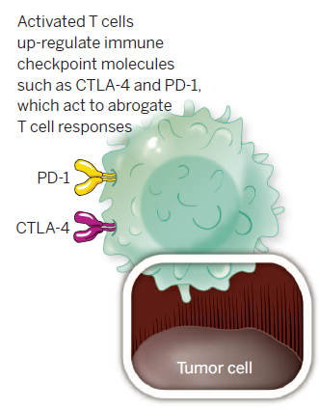
Representative FACS Binding Assay for Activated PBMCs
Padmanee Sharma et al. (2015) Science 348:56-61
Antibody | Clone # | Human PD1 EC50 | Cyno PD1 EC50
PD1-mAb012 | 9B2C6C9 | 1.82 nM | 3.11 nM
PD1-mAb027 | 76G5B3 | 0.77 nM | 1.43 nM
To confirm binding of candidate mAbs to native PD-1, activated human peripheral T cells which upregulate PD-1 on the cell surface were used to test binding of candidates by flow cytometry. Purified human CD4+ T cells were activated by plate-bound anti-CD3 antibody. Human CD4+ T cells were prepared from PBMCs.

Slide 38


Representative Cell Based Ligand Binding Blocking Assay by FACS
Candidate mAbs
CHOK1-hPD-1
Biotin
PD-1
PD-L1-Fc/
PD-L2-Fc
Antibody | Clone # | Human PDL1 |  | Human PDL2
 |  | Max (%) | IC50 | Max (%) | IC50
PD1-mAb012c | 9B2C6C9 | 94 | 10.8 nM | 85 | 2.47 nM
PD1-mAb027c | 76G5B3 | 95 | 0.29 nM | 100 | 0.49 nM
PD1-mAb059c | 223G6B5 | 95 | 0.24 nM | 86 | 0.82 nM
Keytruda | Merck | 60 | 0.12 nM | 47 | 0.15 nM
Serial dilutions of candidate mAbs (from 0.001 to 100nM) were incubated with transfected CHO cells expressing human PD-1. Biotin-conjugated recombinant human PD-L1-Fc or PD-L2-
Fc fusion protein was then added. Binding of the ligand to PD-1 on the CHO cell surface was detected by flow cytometer.

Slide 39
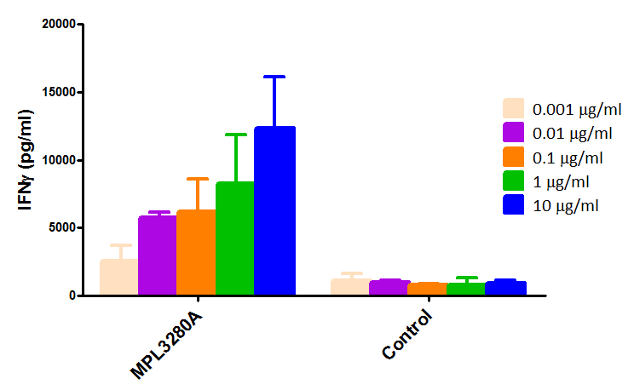
T Cell Stimulation Assay-Representative data using optimized condition
T Cell Stimulation Assay
MPDL3280A dose dependently stimulated IFNγ production of primary T cells

Slide 40
Representative Mixed Lymphocyte Reaction Assay

Slide 41
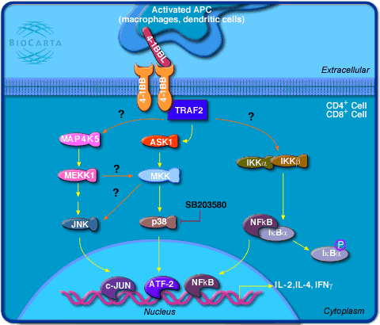
Representative Luciferase Reporter Assay
4-1BB signal pathway
Urelumab
MOR7083
293F-hCD137
NF-kb-RE
luc2P
Urelumab and MOR7083 can activate NF-kB activation through 4-1BB signal pathway

Slide 42
Representative Cell Adhesion Blocking Assay
Cell adhesion assay format
Cell Titer-Glo
Ligand coating concentration
Cell number
Incubation time
Assay buffer
Wash procedure
Assay condition optimization
Cell line
Receptor
Y
Tool antibody can block specific receptor expressing cell adhesion to its corresponding ligand.
Tab
Ligand-1

Slide 43
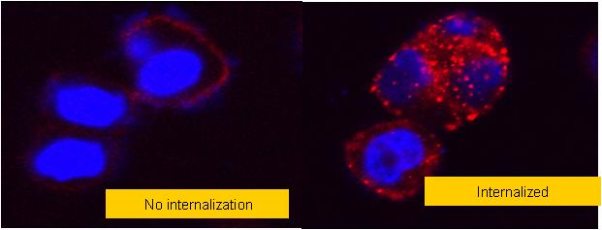
Other Representative Cell Based Functional Assays
Antibody internalization assay
FLIPR Calcium Flux Assay
Notes:
These are non-specific stimulations that will activate most T cells (anti-CD3 and Con A) or B cells (LPS).

Slide 44
  Hybridoma Platform

Slide 45

Hybridoma Platform
Immunogen and antigen preparation
  Protein production and cell line development
  Peptide and compound design and synthesis
  In vivo transfection
Animal immunization
  Multiple SPF species: mouse, rat, hamster, transgenic mice
  Customized program based on target biology and assays
  AAALAC accredited and licensed animal facility
Hybridoma development
  High fusion efficiency electrofusion available
  ELISA/Acumen screening and customized functional screening
  Isotyping/epitope binning by ELISA and affinity ranking by Biacore
Binding and bioassay
  Ensure all necessary assays in place before immunization
  ELISA, Acumen and FACS are standard assays, and can be customized
  Comprehensive bioassays can be developed and performed
Antibody production
  Working and master cell banking
  in vitro, in vivo production and affinity purification
  Low EU purification for bioassay and in vivo study
  Rigorous quality and functional testing
SPF Animal facility

Slide 46
Technical Highlights
SPF animals and multiple species/strains
Animal strains with superior immune response to membrane protein targets
Novel tolerance breaking technology for high homology and conservative antigens.
Genetic immunization and in vivo transfection
Extensive experiences in use of Transgenic mice
  Harbour mice - H2L2 and HCAb mice platforms
  Trianni mice – preferred service provider and partner
Well established binding and functional assays

Slide 47
CPSJ Mice for Conservative Protein Targets
Test bleed antisera titer comparison of Balb/c mice and CPSJ mice after immunization with IGF1R antigen
Comparison of hybridoma clones obtained from different mouse strain of a typical project for a cell membrane protein target
47

Slide 48
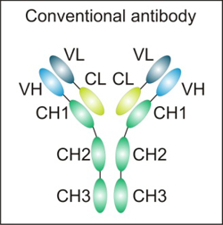
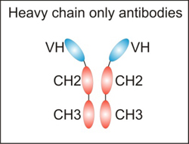
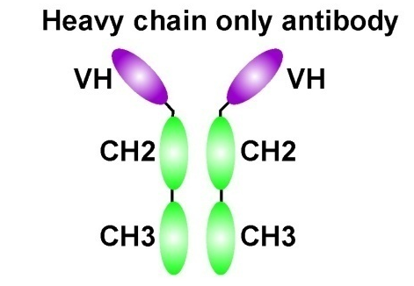
Harbour Antibodies
H2L2 Platform
Conventional antibody
12 therapeutic antibody programs
in ChemPartner
Comparable immune response for
WT and transgenic mice
Fully human mAb with great VH/VL and epitope diversity and nM or better affinity
Great manufacturability and biophysical properties
Heavy chain only antibodies
VH1
VH1
VH1
CH2
CH2
VH1
CH3
CH3
VH2
HCAb Platform
Bispecific HCAb
Bispecific sdAb
sdAb

Slide 49

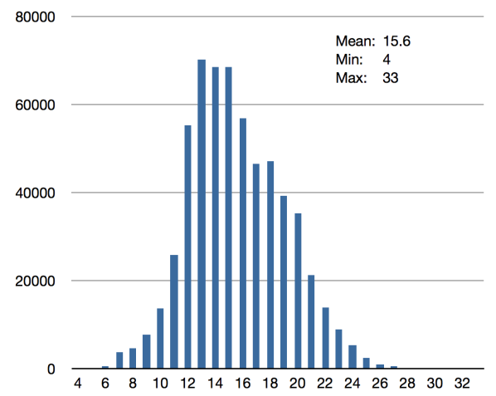
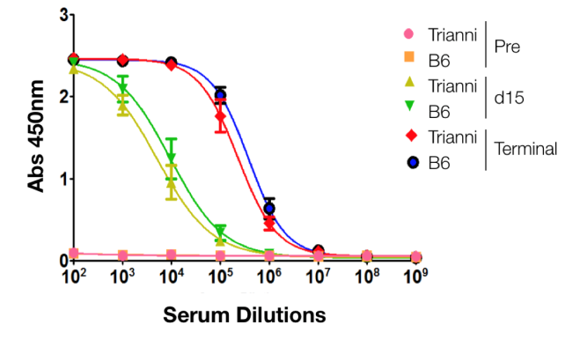
Trianni Mice Technology
Distinctive Features of Trianni’s Technology
Elimination of endogenous V, D and J gene segments
Humanization of all three antibody loci
  H, K, L
Designed immunoglobulin alleles
  Targeted insertion of arrays of synthetic antibody gene segments
  Optimizations throughout the arrays
  Chimeric gene segments (important re FTO)
    Mouse noncoding (regulatory) DNA
    Human coding DNA
Platform flexibility
  Refinements can be generated quickly
  Alternative repertoire mice in development
H CDR3 Length Distribution
Test Bleed ELISA Titer
Both WT and Trianni Mice mount strong and similar immune responses

Slide 50
Typical Antibody Generation and Screening Process
< 10
/E1
> 10,000
> 1000
> 100
< 10
/E2
3-5 Candidates
Potency
CDR sequence
Property
< 10
/E3
< 10
/E4
Hybridoma
Screening
Production/purification
Functional
Antibody
Candidate
Antibody

Slide 51
Representative Candidate mAb Characterization
Candidate mAbs
Biacore
ELISA
Reactivity confirmation
FACS
RBA
PBMC/Tumor cell co-culture
Function
confirmation
MLR
T Cell Stimulation
ADCC/CDC/
Apoptosis
Solubility
/Stability
Rodent PK
In vivo pharmacology

Slide 52
Presentation Outline
Protein generation and cell line development
Screening and functional assays
Hybridoma and pilot antibody production
Phage display for antibody discovery
Antibody engineering and bioinformatics
ADC discovery
Biophysical characterization

Slide 53
  Phage Display for Antibody Discovery

Slide 54
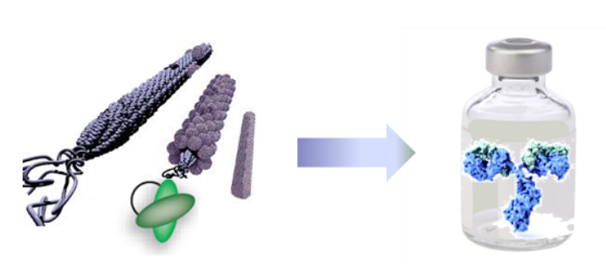
CP Phage display Platform
Human naïve antibody library
  PBMCs isolation from 50+ diversified human donors
  V-gene families cloning and assembling into phagemid
  Phage library size 10^{10~11}
Immune library
  PBMCs isolation from immunized animals
  V-gene families cloning and assembling into phagemid
  Phage library size 10^{8~9}
Biopanning
  Protein panning in solid & solution-phase
  Cell based panning
  In vivo panning
Binding and bioassay
  ELISA, Acumen and FACS are standard assays, and can be customized
  Comprehensive binding and bioassays can be supported by other teams
Antibody affinity maturation
  scFv affinity libraries construction by CDR targeted mutagenesis, with a focus on H3
  Library panning against Ag at various conditions
  Initial screening with ELISA & off-rate ForteBio ranking
  Characterization of best clones in hIgG format by Biacore and bioassays

Slide 55
Phage display and hybridoma technologies complement each other in antibody development
 | Hybridoma technology | Phage display
Efficiency | 6~8 months for standard package + 2~3 months humanization | High, a fast route to an initial set binders (~4 months); no need for humanization if identified from human library
Repertoire | Natural | Natural or designed
Antigen | Challenging for toxic, conserved and less immunogenic | All kinds of antigens
Affinity | Most times no need for affinity maturation | Sometimes needs affinity maturation; Large library is required to identify good binders
Screening format | IgG | scFv & Fab, not IgG due to size

Slide 56
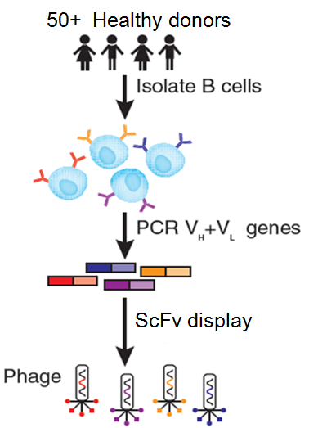
Antibody discovery from human naïve library
Antigen
~4 weeks
Antigen production and validation
Selection
8~10 weeks
Library panning against antigen using tailor-made protocols
Selection of panning output by ELISA or FACS
Production &
Characterization
4~5 weeks
Full IgG conversion of promising candidates
Testing of panning and screening conditions
Expression and purification of IgG in mammalian cells
Functional characterization by Biacore and bioassays
Protein characterization by SDS-PAGE, SEC-HPLC
Sequences analysis and selection of unique clones
Royalty-Free

Slide 57
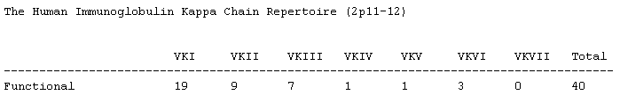
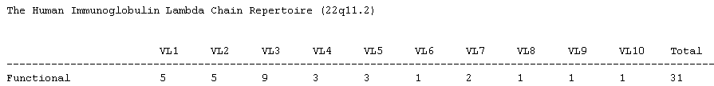
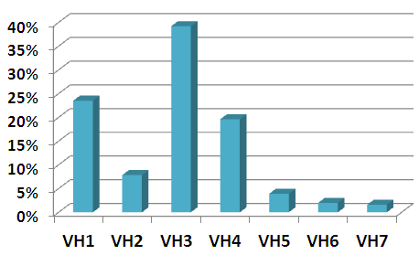
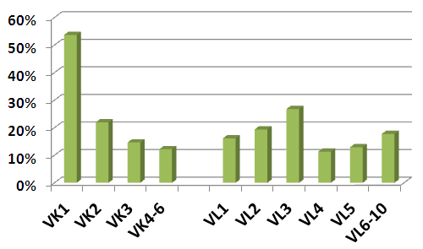
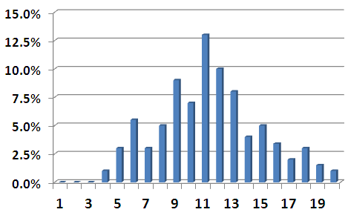
CP naïve library matches natural V-gene composition and has high sequence diversity
VH
Vκ
Vλ
Human V gene families
CDR-H3 length distribution
(sequences analysis of ~1000 of random clones from CP library; all sequences are different)

Slide 58
CP Naïve Library Case Study: Targeting IL-1β
Biacore
IgG Clone | k_{a} (1/Ms) | k_{d} (1/s) | K_{D} (M)
1# | 4.226E+04 | 9.008E-04 | 2.131E-09
2# | 6.140E+05 | 1.970E-04 | 3.208E-10
3# | 1.635E+04 | 7.518E-05 | 4.598E-09
4# | 3.592E+05 | 2.738E-05 | 7.623E-11
5# | 5.053E+04 | 2.449E-05 | 4.846E-10
6# | 7.283E+04 | 3.114E-05 | 4.276E-10
576 clones from 3rd round panning output screened by ELISA, 65 positives
Best output clones exhibit sub-nM affinity, when converted to full-length IgG

Slide 59
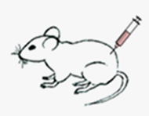
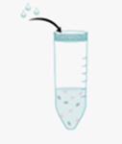
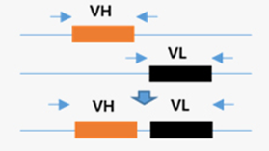
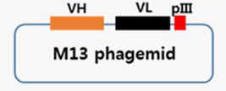
Antibody discovery from immune library
Antigen
~4 weeks
Isolation of B cells from immunized animals
Selection
8~10 weeks
Library panning against antigen using tailor-made protocols
Selection of panning output by ELISA or FACS
Production & Characterization
4~5 weeks
Full IgG conversion of promising candidates
Phagemid library construction and validation
Expression and purification of IgG in mammalian cells
Functional characterization by Biacore and bioassays
Protein characterization by SDS-PAGE, SEC-HPLC
Sequences analysis and selection of unique clones
Immune library
~4 weeks
Antigen production and validation
Testing of panning and screening conditions

Slide 60
Advantages of immune library for antibody discovery
Immune library VS naïve phage library
  Better chance to get high affinity Ab from immune library due to the affinity maturation by the animal immune system
  Small library size (e.g. 10⁸) is sufficient to isolate good Abs from immune library due to a high frequency of antigen-specific B-cells in immunized animal
Immune library VS hybridoma
  Immune library has much better coverage of immunogen(s)-specific antibody repertoire of an immunized animal
  Immune library incorporate an enriching step that can selectively isolate antibodies of desired functionality

Slide 61
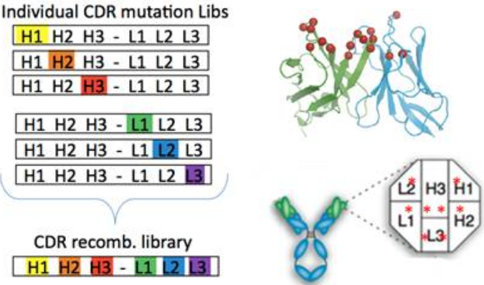
Affinity Maturation by Phage Display
Antigen
~4 weeks
Biotinylation of antigen
Mutagenesis library
4~5 weeks
Construct scFv affinity libraries by CDR targeted mutagenesis
Selection
8~10 weeks
Conversion of promising candidates to IgG or Fab format
Production & Characterization
4~5 weeks
A library is constructed for each CDR, with a focus on H3
Other CDR libraries optional, and can combine later
Library validated by sequencing 50 clones for mutational rate
Selection process can be performed by systematically reducing the antigen concentration or by competition with free antigen or soluble antibody-fragments
ELISA screening and Biacore ranking of the improved scFv variants
Expression and purification of IgG in mammalian cells
Protein characterization by SDS-PAGE, SEC-HPLC
Functional characterization by Biacore and bioassays
Antigen validation includes biochemical and biological properties
Testing of coating condition on straptavidin plates or beads

Slide 62
Case Study: Affinity Maturation of Anti-IL1β by CDR Mutagenesis
Parental Ab
Ab ID | CDR-H2 | CDR-L1 | k_{a} (1/Ms) | k_{d} (1/s) | K_{D} (M)
parental | wild type | wild type | 2.215E+05 | 7.284E-04 | 3.288E-09
#1 | -A-I- | wild type | 3.967E+05 | 9.469E-05 | 2.387E-10
#2 | wild type | -RTV- | 3.328E+05 | 1.520E-04 | 4.567E-10
#3 | wild type | -SVV- | 4.093E+05 | 1.320E-04 | 3.226E-10
#4 | -A-I- | -RTV- | 4.887E+05 | 3.010E-05 | 6.159E-11
#5 | -A-I- | -SVV- | 5.063E+05 | 2.439E-05 | 4.817E-11
#5: ~70X improvement
Combination of mutations from two CDRs yield ~70 fold improvement in full-length IgG KD measured by Biacore

Slide 63
  Antibody Engineering and Bioinformatics

Slide 64
Antibody Engineering and Informatics Analysis
VH/VL Sequencing
Confirm sequences by MS
Validation by chimeric antibody production
Sequence Analysis
CDR grafting and back mutation by computer modeling
Production of variants and characterization
Affinity Maturation
Random mutagenesis and phage display
Variants production and characterization
Humanization
1-2 months
  Sequence alignment
  AA analysis
1-2 days
2-3 months
3-4 months

Slide 65
Outline of Antibody Humanization
Determine the canonical structures of the parental VH/VL
Select the best germline framework based on homology
Select the J region based on homology
Identify residues critical in loop conformation and interface
Identify residues within 5Å of CDR binding region by modeling
Design
1-2 weeks
Vector construction of multiple humanized Ab with various back- mutation
Expression and purification of humanized Abs
Characterization of humanized Abs by SEC, SDS-PAGE and Endotoxin detection
Variants
generation
6-7 weeks
Primary screening by ELISA or FACS
Affinity measurement by Biacore
Identify the Ab best retains function while has minimal
back-mutation
Deliver full report and all material
Characterization
~4 weeks

Slide 66
Successful Track Record _ Selected Humanization cases
No. | Client | Type of target | KD (M) parental mAb | KD (M) humanized mAb
1 | International pharma., R&D center in China | Cell membrane | 6.58E-10 | 6.39E-10
2 | Academic Lab in China | Cell membrane | 1.26E-10 | 1.21E-10
3 | Top biotech Co. in US | Soluble | 2.27E-12 | 2.78E-12
4, 5 | Multinational health care Co. | Soluble | 5.49E-09 | 4.03E-09
 |  | Soluble | 1.09E-09 | 0.93E-09
6,7 | Multinational pharma. in US | Cell membrane | 2.07E-09 | 7.06E-10
 |  | Cell membrane | 1.20E-08 | 1.15E-08
8-12 | Top domestic pharma. | Soluble | 3.05E-11 | 9.66E-12
 |  | Soluble | 3.62E-12 | < 1.00E-12
 |  | Soluble | 3.30E-09 | 2.45E-09
 |  | Soluble | 7.80E-09 | 8.20E-09
 |  | Soluble | 1.35E-09 | 1.88E-09
13 | Multinational pharma., R&D center in China | Cell membrane | 2.84E-10 | 3.42E-10
14 | Multinational health care Co. | Soluble | 3.26E-10 | 2.82E-10
15 |  | Soluble | 8.90E-10 | 1.07E-08
16 | Multinational pharma. in US | Cell membrane | 5.33E-11 | 3.32E-11
17 |  | Cell membrane | <1.00E-12 | <1.00E-12
18 |  | Cell membrane | 1.10E-08 | 2.08E-09

Slide 67
Case study: humanization of Murine mAb 11F9
7 humanized VH and 2 humanized VL were designed and fused on human IgG1/k constant region.
Each heavy and light chain were paired to generate 14 humanized 11F9.
Chimeric 11F9 was produced as positive control.
VH (VH3- 72) +JH1 VK (A2) + Jk2 | H11F9VH.1 (CDR-grafted) | H11F9VH.1A (49, 94) | H11F9VH.1B (93, 94) | H11F9VH.1C (49, 93, 94) | H11F9VH.1D (78, 93, 94) | H11F9VH.1E (49, 78, 93, 94) | H11F9VH.1F (49, 78, 93, 94, 76) | 11F9VH Chimeric
H11F9Vk.1 (CDR-grafted) | hu11F9-1 | hu11F9-2 | hu11F9-3 | hu11F9-4 | hu11F9-5 | hu11F9-6 | hu11F9-7
H11F9Vk.1A(4) | hu11F9-8 | hu11F9-9 | hu11F9-10 | hu11F9-11 | hu11F9-12 | hu11F9-13 | hu11F9-14
11F9Vk chimeric |  |  |  |  |  |  |  | 11F9 Chimera

Slide 68
Summary of Humanized 11F9
Sample | Number of Back-mutation | Monomer % | KD (M) to hu Ag
Chimeric 11F9 |  | 99.8 | 2.27E-12
hu11F9-1 | 0 | 100 | No binding
hu11F9-2 | 2 | 100 | 8.67E-12
hu11F9-3 | 2 | 99.7 | 5.55E-12
hu11F9-4 | 3 | 97.3 | 2.78E-12
hu11F9-5 | 3 | 100 | 5.975E-12
hu11F9-6 | 4 | 99.7 | 3.08E-12
hu11F9-7 | 5 | 99.8 | 6.678E-12
hu11F9-8 | 1 | 100 | No binding
hu11F9-9 | 3 | 97.9 | 5.565E-12
hu11F9-10 | 3 | 99.9 | 4.97E-12
hu11F9-11 | 4 | 97.5 | 3.97E-12
hu11F9-12 | 4 | 98.3 | 5.732E-12
hu11F9-13 | 5 | 99.9 | 4.138E-12
hu11F9-14 | 6 | 98.1 | 3.917E-12

Slide 69
Structure biology support for Biologics Discovery Service
Homolog modeling/Antibody modeling tools;
  Prediction of CDR from sequence;
  Rapid prediction using curated antibody database;
Protein-protein/antibody-antigen docking;
Prediction and evaluation for protein engineering;
  Cysteine scanning to identify residue mutations for potential cysteine-cysteine disulfide bonds;
  Automated residue scanning to predict relative stabilities as well as changes in solvent‑accessible surface area;
  Identification of hot spots for proteolysis, glycosylation, deamidation, and oxidation;
  Humanization: CDR grafting/Residue mutation;
  Residue-based analysis of energies, solvent-accessible surface areas;
Simulation tools
  Advanced molecular dynamics (MD);
  Extensive Free Energy Perturbation (FEP) tools;
  Large-scale, low mode (normal) search for domain movement;

Slide 70
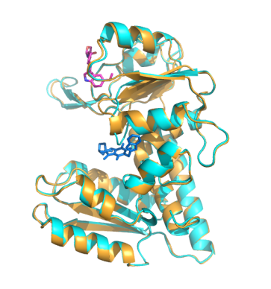
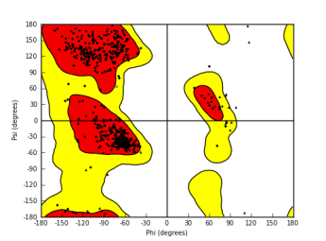
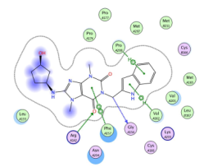
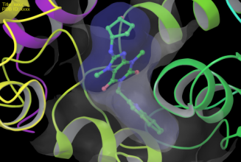

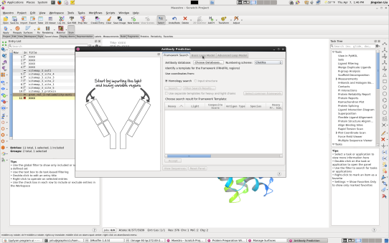
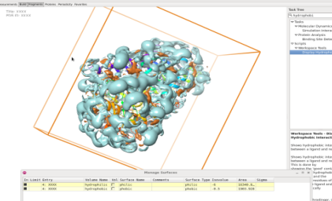

Structural Bioinformatics
Pymol, Schrodinger package, MOE (shared with medicinal chemistry), chimera, graphics workstation;
PPI, PISA, protein-compound complex analysis, docking, Induced fit docking and simulation;
Key interaction analysis: π-π interaction, π-cation, salt-bridge, hydrophobic interaction;
Binding energy estimation (MM-GBSA), molecular dynamics;
Peptide qsar, aggregation surface, binding site detection, Hydrophobic/philic analysis, protein reliability report, electrostatic surface
Ligand interaction
Pocket surface
Ramachondron plot
Antibody
Modeling
CD64,
Docking IFD
Hydrophobic
surface

Slide 71
  ADC Discovery

Slide 72


ChemPartner ADC Capabilities Overview
Full Biologics Capability
Antibody discovery
Experienced with different conjugation chemistries
Established ADC production and Purification process
Complete ADC quality control
Established Chemistry Capability
High potency lab facility (OEB-5)
25 Chemists with experience in payloads, linkers and conjugation chemistry
Established chemistry for existing toxins
Complete In Vivo Study Capabilities
PK –PD
  Mouse, rat, monkeys available
  bioanalytical assay development
Toxicity
Pharmacology
  Efficacy study in >124 cell line xenografts and162 PDXs (patient derived xenografts)
  Biodistribution
AAALAC accredited animal facilities
LC-MS system for antibody analytics

Slide 73


OEB-5 High Potency Lab
Operation Qualification (OD) assessment carried out
Certified by Golder Associates, USA
High potency lab is up and running
  Lonza classification: OEB-5 (OEL < 1 ug/m3)
  Synthetic scale up to 50 g toxin
High Potency Lab in Bldg 10
Chemists working with toxin

Slide 74
Extensive ADC Conjugation Experiences
Experiences of >500 ADC conjugates and > 300 other bioconjugates
Different payloads
  Worked with different payloads, DM1, MMAE, MMAF
  Experienced with other toxins:PBD-1, Doxorubicin, Vinblastine, Cabazitaxel, etc.
Different antibodies
  human antibodies, murine antibodies, chimeric antibodies
Conjugation strategies
  Worked with both lysine and cysteine conjugation strategies
  Cleavable and non-cleavable linkers
Scale: mgs - grams of antibody
Turnaround time, timelines
  2-3 weeks turnaround time for conjugation and characterizations

Slide 75
Well Established In Vitro Characterization Assays
 | QC and characterization Items | Assays
1 | Protein Quantity | UV Spec, BCA
2 | Purity | SDS-PAGE (reduced and non-reduce), HPLC-SEC, HIC, RP
3 | Molecular weigh | SDS-PAGE, LC-MS
4 | Endotoxin | LAL
5 | Antigen binding activity | ELISA， FACS， Biacore
6 | DAR (Drug antibody ratio) | UV spec, LC-MS, HIC
7 | Free antibody | LC-MS, HIC
8 | Linker residue | MS
9 | Drug reside | MS
10 | Organic solvent | GC
11 | Isoelectric point | cIEF
12 | Peptide map | Enzyme digestion and RF-HPLC
13 | Conjugation site map | MS/MS
14 | Bioburden | Two-Media Bioburden Test
15 | In vitro efficacy | Cytotoxicity assay
16 | Bioactivity | ADCC, CDC, proliferation assay, etc

Slide 76
Case Study: Target mediated PK in Monkey (relevant species)
Cyno monkeys were dosed with T-DM1 (generated by CP) or Kadcyla® single dose IV.
Non-linear PK at dose from 0.3 mg/kg to 10 mg/kg suggested target mediated clearance in relevant species.
PK profile of T-DM1 is superimposable with Kadcyla® at 1 mg/kg
Lower limited of quantification at 30 ng/ml for total antibody and conjugated antibody assay, 0.2 ng/mL for free DM1 and MCC-DM1 detection, and 0.1 ng/mL for free Lys-MCC-DM1 detection.

Slide 77
Case Study: 5-Day Acute Toxicity DRF Study in SD Rats
Acute toxicity of DM1 conjugated herceptin via SMCC linker (T-DM1) was assessed in SD rats. ALT (A) and AST(B) enzyme level in serum 5 days post 30mg/kg and 60mg/kg treatment. Data demonstrated CP T-DM1 is well-tolerated in treated rats similar to Kadcyla of Genentech product.
A
B

Slide 78
Case Study: In Vivo Efficacy Study In NCI-N87 Xenograft Model
In vivo efficacy of Herceptin-DM1 conjugate (T-DM1) through the thioether SMCC linker was assessed in a herceptin-resistant gastric carcinoma cell line NCI-N87 xenograft mouse model. Data shows tumor growth inhibition and complete regression of tumors in NOD-SCID mice after 3 doses i.v. injection of T-DM1 (3mg/kg and 15 mg/kg) compared to insignificant efficacy of unconjugated herceptin antibody treatment (n = 10 mice per group).

Slide 79
Case Study: In Vivo Efficacy Study In NCI-H1975 Xenograft Model
In vivo efficacy of ADCs with different payload-linkers were evaluated with human lung cancer cell line NCI-H1975 based mouse xenograft model. Data shows MMAF conjugated mAb 3306-hu028 inhibit tumor growth at different dosages, while MMAE conjugated the same antibody showed more complete regression of tumors. Interestingly DM1 conjugated the same antibody showed no sign of tumor growth inhibition although it worked well during in vitro cell based assays

Slide 80
Safety Assurance
Dedicated ADC Labs
  Dedicated ADC high potency lab
  Dedicated ADC conjugation and analytical group
  Key in-process equipment and resources dedicated in ADC labs
Waste stream
  Wastes collected in specialized containers and processed by qualified vendor
Safety monitoring
  Review and evaluate toxicological/clinical data against occupational health categories; ‘safe’ limits based on existing data for occupational exposure to a compound
  Standard operating procedures for handling and disposal of high potency substances is in place based on their occupational health category.
  Trained employees in potent compound safety and product handling practices and toxicology
Proximity
  Completely separated room/ventilation

Slide 81
Presentation Outline
Protein generation and cell line development
Screening and functional assays
Hybridoma and pilot antibody production
Phage display for antibody discovery
Antibody engineering and bioinformatics
ADC discovery
Biophysical characterization

Slide 82
  ADC Discovery

Slide 83
Overview
Major Instruments
  Q-TOF MS, QE MS
  Multiple HPLCs with DAD, MS, MALLS, RI and viscosity detectors
  Lyostar II
  cIEF, CE, DSC
  High throughput DLS
  Biacore, Octet Red96
Customers
  US and European based pharmaceutical companies
  Chinese pharmaceutical companies
Operation
  Instrument IQ/OQ/PQ; SOP, Training and login system
  Documentation: Notebook, e-notebook, analytical report, study report, batch record, raw data
  IND, NDA, ANDA, BLA submissions

Slide 84
Biophysical Characterization Capabilities
 | Parameter |  | Method
Primary sequence | Composition |  | Amino acid analysis (AAA)
 | Sequence confirmation |  | Peptide mapping, LC-MS/MS
 | Glycosylation analysis |  | LC-MS/MS
 | Disulfide bond shuffling |  | LC-MS/MS
 | Charge analysis |  | cIEF, IEX
 | Degradation |  | SEC, RPC, SDS-PAGE, cIEF, IEX, HIC
Secondary structure | CD
Tertiary structure | Intrinsic fluorescence
 | 2nd derivative UV
Aggregation | Aggregates | SEC-MALLS, SDS-PAGE
 | Size | Dynamic Light Scattering (DLS)
Thermal stability | Capillary DSC
 | High throughput DLS
Activity | Biacore, ELISA, Cell based assays

Slide 85

Biomolecular Interaction Analysis Platform
Kinetics
Affinity
Concentration
Specificity
Thermodynamics
How fast, strong & why…
Is the binding of a lead antibody or compound?
How specific & selective...
Is this drug binding to its receptor?
How much...
Biologically active component is in a production batch?
Various Types of Interaction Analysis
  Antibody-antigen or receptor-ligand interaction characterization: affinity, kinetics
  High-throughput compound library screening
  K_{D} measurement of compounds from target protein
  scFV or antibodies screening and ranking
  Identifying the logical sequence of binding events for multimolecular complexes
  Epitope binning, isotyping and cross-reactivity test of antibodies.
Biacore Models
  Biacore X100
  Biacore T200
ForteBio Model
  Octet Red 96
Notes:
Biacore is a high performance system for analysis of biomolecular interactions, based on surface plasmon resonance (SPR) technology

Slide 86


SEC Method to Study Protein Aggregation
UV280
Stress-1
SLS
UV, SLS RI
Molecular Weight
RI
Peak | MW
HWM | 302KD
Main | 155KD
Stress-2
In addition to peak separation, the peak identity can be determined by the absolute molecular weight provided by the multi-detectors.

Slide 87
Thermal Stability by DLS Reflects Aggregation Behavior
5 mg/mL
1. Thermal stability ranks candidates and formulations based on the unfolding temperature and the amount of aggregates
2. The unfolding and aggregation of mAB at low concentration can not predict those at high concentration. It is critical to evaluate protein stability at target formulation concentration at candidate selection and formulation development stage when sample amount very is limited.
3. SEC excludes large aggregates or gels, and breaks reversible aggregates by mobile phase dilution. DLS reflects in situ situation.
50 mg/mL

Slide 88
Thermal Stability by Differential Scanning Calorimetry
DSC is commonly used in formulation and candidate selection. It measures the unfolding temperature (Tm) of proteins. Tm correlates with chemical and physical stability of proteins. As shown above, this IgG is more stable at pH 6.5 and pH 7.5 than pH 4.0.
Our high throughput model uses less than 1 mg protein.

Slide 89
  COMMON TOPICS ABOUT ANTIBODY GENERATION

Slide 90
Available Approaches for Antibody Generation in CP
Hybrdoma technology
  WT mice, rat and hamsters
  Transgenic mice (Harbour mice, Trianni mice)
Phage display technology
  Naïve library
  Immune library

Slide 91
Experiences in Use of Transgenic Mice
Harbour mice – H2L2 (since 2011)
  Preferred service provider
  Technology evaluation (3 programs)
  Therapeutic programs
    9 on-going IS projects, 3 in pre-clinical development
Harbour mice – HCAb (since 2014)
  Technology evaluation (2 programs)
Trianni mice
  Preferred service provider
  2 on-going therapeutic projects

Slide 92
Immunization Strategies
Combined Immunization Strategies
Immunogens
Peptides
Proteins
Cells
DNAs
Nanodisc
Animals
Mouse
Rat
Hamster
KO
Tg
Adjuvant
Freund’s
Gerbu
TiterMax
RIBI
Routes
IP
Hock
S.C.
IV

Slide 93
Representative Immunization Plan
Cohorts | Immunogens | Route | Animal Strains | Group size | Dosage (ug or cells) | Adjuvant
1 | Purified Proteins | I.P. | BalbC | 10 | 25~50 | CFA/IFA
2 |  | I.P. | SJL | 10 | 25~50 | CFA/IFA
3 |  | hock | BalbC | 5 | 5 | Gerbu
4 |  | hock | SJL | 5 | 5 | Gerbu
5 | Over-expression cell lines | I.P. | BalbC | 10 | 0.5-1x10⁷ cells | N/A
6 |  | I.P. | SJL | 10 | 0.5-1x10⁷ cells | N/A
7 | DNA plasmid | Gene gun | BalbC | 5 | 4 | N/A
8 |  | Gene gun | SJL | 5 | 4 | N/A

Slide 94

Antibody to High homology proteins, case-1
Human Receptor R2
96% Identical to mouse

Slide 95

Antibody to High homology proteins, case-1
Test bleed 2, FACS, Baf3-3068R2IIIb
SJL
SJL
Balb/c
Balb/c

Slide 96
Typical Antibody Generation and Screening Process
< 10
/E1
> 10,000
> 1000
> 100
< 10
/E2
3-5 Candidates
Potency
CDR sequence
Property
< 10
/E3
< 10
/E4
Hybridoma
Screening
Production/purification
Functional
Antibody
Candidate
Antibody

Slide 97
Antibody Engineering and Informatics Analysis
VH/VL Sequencing
Confirm protein sequences by MS
Validation by chimeric antibody production
Sequence Analysis
CDR grafting and back mutation by in silico modeling
Production of variants and characterization
Affinity Maturation
Random mutagenesis and phage display
Variants production and characterization
Humanization
Engineering for lead optimization
Fc function, expression, PTMs, stability
1-2 months
  Sequence alignment
  Hotspots analysis
1-2 days
2-3 months
3-4 months
1-2 months
97

Slide 98
Manufacturability/Drugability Assessment
Manufacturability/
Drugability
Candidate mAb Selection
Engineering/
optimization
Cell line development
Process development
Formulation

Slide 99
Biophysical Characterization Capabilities
 | Parameter |  | Method
Primary sequence | Composition |  | Amino acid analysis (AAA)
 | Sequence confirmation |  | Peptide mapping, LC-MS/MS
 | Glycosylation analysis |  | LC-MS/MS
 | Disulfide bond shuffling |  | LC-MS/MS
 | Charge analysis |  | cIEF, IEX
 | Degradation |  | SEC, RPC, SDS-PAGE, cIEF, IEX, HIC
Secondary structure | CD
Tertiary structure | Intrinsic fluorescence
 | 2nd derivative UV
Aggregation | Aggregates | SEC-MALLS, SDS-PAGE
 | Size | Dynamic Light Scattering (DLS)
Thermal stability | Capillary DSC
 | High throughput DLS
Activity | Biacore, ELISA, Cell based assays

Slide 100
  Case Study _ Manufacturability data for humanized mAbs
DSC
3306-hu005-12
3306-hu028-3
Antibody Code | T_{M} of Fab ( °C)
Hu3306-005-12 | 78.94
Hu3306-028-3 | 71.17
DLS
Heat induced aggregation
Antibody Code | T_{onset} ( °C)
Hu3306-005-12 | 74
Hu3306-028-3 | 66

Slide 101
Case Study _ Manufacturability data for humanized mAbs
Storage
3306-hu005-12
CiEF
3306-hu028-3
2
Store at different temp for 1w：
Ab No. | Temp. | Aggregation (%)
 |  | 1 | 2 | 3 | ave-Agg
3306-005-12 | 4℃ | 3.21 | 4.26 | 3.24 | 3.57
 | 25℃ | 4.22 | 4.38 | 4.04 | 4.21
 | 37℃ | 3.74 | 3.68 | 3.86 | 3.76
 | -80℃ | 3.18 | 3.2 | 3.08 | 3.15
3306-028-3 | 4℃ | 0.07 | 0.19 | 0.16 | 0.14
 | 25℃ | 0.08 | 0.25 | 0.27 | 0.20
 | 37℃ | 0.2 | 0.21 | 0.21 | 0.21
 | -80℃ | 0.17 | 0.26 | 0.19 | 0.21
2
7.05
7.05
9.77
9.77
1
1
3
37℃
3
-80℃
4℃
25℃
25℃
4℃
37℃
-80℃
4℃
Ab No. | Temp. | Aggregation (%)
 |  | 1st | 2nd | 3th
3306-005-12 | 4℃/-80℃ | 2.89 | 4.33 | 2.9
 | 25℃/-80℃ | 3.32 | 3.44 | 3.73
 | 37℃/-80℃ | 3.16 | 3.52 | 3.58
3306-028-3 | 4℃/-80℃ | 0 | 0 | 0
 | 25℃/-80℃ | 0 | 0 | 0
 | 37℃/-80℃ | 0 | 0 | 0
Freeze thawing
-80℃
3 cycles
25℃
37℃
Ab No. | Conc. | Aggregation (%)
3306-005-12 | 30 mg/ml | 2.99
 | 60 mg/ml | 3.25
 | 100 mg/ml | 2.98
3306-028-3 | 30 mg/ml | 0
 | 60 mg/ml | 0
 | 100 mg/ml | 0
Concentration
30mg/ml
60mg/ml
100mg/ml

Slide 102
Thanks !

Slide 103
Activities |  |  | Reagent Antibody Project | Therapeutic Antibody Program
Project initiation |  | Target biology analysis | N | Y
 |  | Project proposal | Y | Y
 |  | Project workplan | N | Y
Reagent generation |  | DNA constructs (proteins and cell lines) | N | Y
 |  | Proteins (multi-species) production | N | Y
 |  | Proteins (family protein/isoforms) production | N | Y
 |  | Reference agents production (proteins, antibodies, compounds) | N | Y
 |  | Generation of Cell lines (immunization) | N | Y
 |  | Generation of Cell lines (assays) | N | Y
 |  | Genetic immunization vectors | N | Y
 |  | Validation (bioactivity and physical properties) | N | Y
Assay development |  | Binding assay (ELISA, FACS, epitope binding, Biacore, WB, etc) | Y | Y
 |  | Bioassays (RBA, proliferation, migration, T-cell assays, migration, etc) | N | Y
 |  | Biophysical/analytical assay | N | Y
Antibody generation | Immunization | Animal strain/species | 2 | multiple
 |  | Route and adjuvant | STD | Flexible
 |  | Protein based | Y | Y
 |  | Cell based | As requested | Y
 |  | Genetic | N | Y
 | Hybridoma | Cell fusions | 2-3 | As desired
 |  | hybridoma screening (binding) | Y | Y
 |  | hybridoma screening (bioactivity) | N | Y
 |  | Hybridoma panel | 5-10 | 50-100
 |  | Pilot antibody production | Y | Y
 |  | ***low endotoxin | N | Y
 |  | ***characterization | Binding | Binding + function
Candidate mAb selection and optimization |  | VH/VL sequencing | As requested | Y
 |  | Humanization | N | As desired
 |  | sequence analysis and optimization | N | As desired
 |  | Manufacturability analysis | N | Y
Project costs |  | FFS | $20k-50k | N
 |  | FTE | N | $500-1000K
 |  | Reagent reimbursement | N | Y
Timeline |  |  | 6-8 months | 12-18 months

